Slide 1
Performance and Availability Improvements of Umbraco V10+ Websites with Hangfire Jobs
Nurhak Kaya

Slide 2
Agenda
Quick intro
Why Hangfire jobs?
How to run Hangfire jobs in Umbraco v10+ websites
Final notes
Q&A

Slide 3
Quick intro
Nurhak Kaya
Technical Architect at Great State in Bristol, UK
Umbraco Certified Master and MVP

Slide 4
Why Hangfire jobs?

Slide 5
Why Hangfire jobs?
Open-Source task scheduler for ASP.NET and ASP.NET Core.
Free
Please watch Per Ploug’s Codegarden 2022 talk about ‘Open-Source Work is Work’
Simple
Easy to set up and use.
No service, scheduler or seperate applications required.
Persistent
Background jobs are created in a persistant storage, like SQL Server.
App pool recyles doesn’t create any problems with Hangfire jobs.
Reliable
Once a job is created, then Hangfire takes care of running it.
Transparent
Built-in web interface to observe the state of each background job and manage them.
Extensible, Efficient etc.

Slide 6
Why you might want to create Hangfire jobs?
Improve availability
Improve performance
Reduce interactive response times
Mainly used to perform background tasks
Batch/email notification,
Batch import files
Video/Image processing
Database maintaining
File purging etc.

Slide 7
A recent example

Slide 8
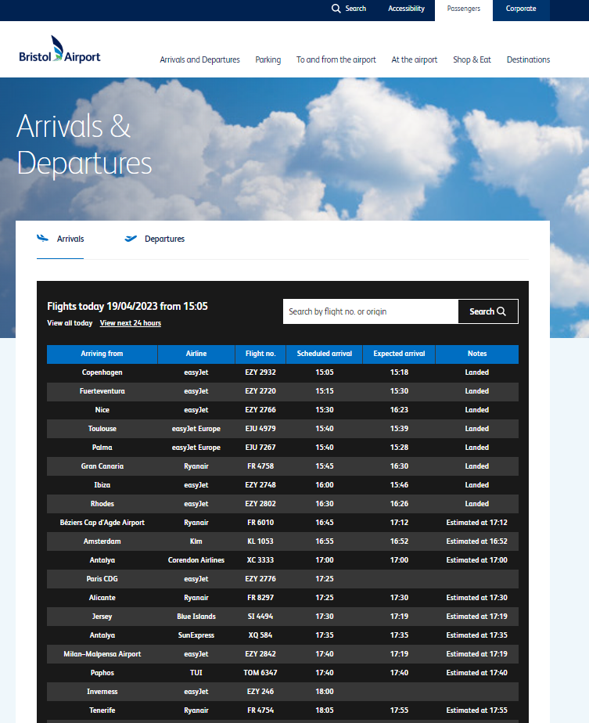
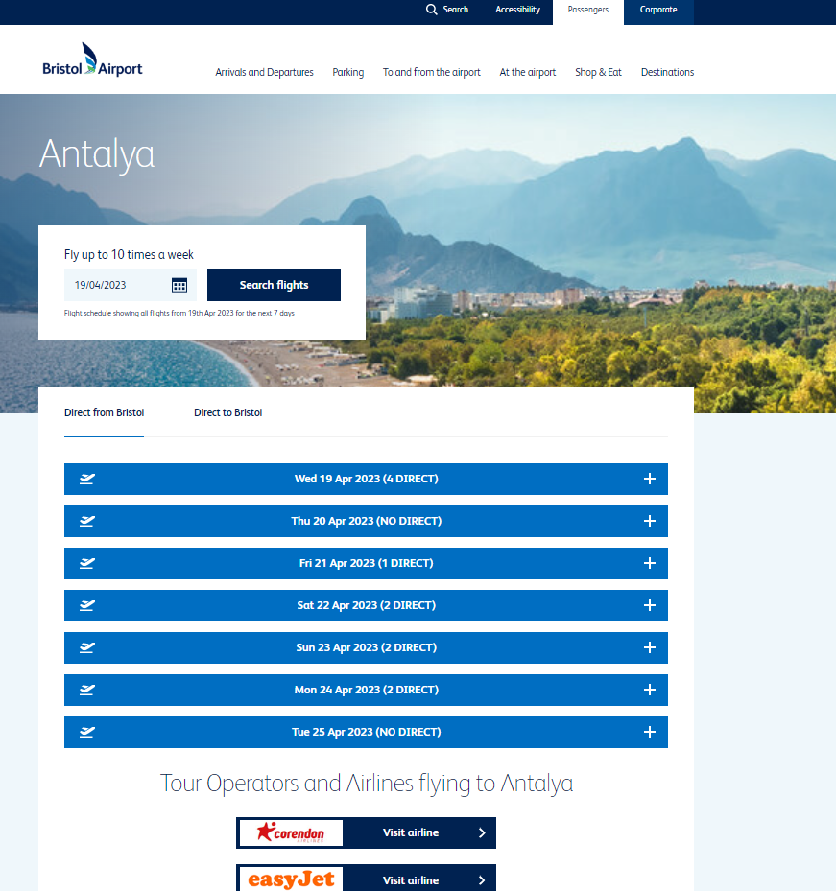
Bristol Airport Website - Flights
Multiple REST and SOAP API calls to get the flights information.
We didn’t want to rely on these 3rd party services but still wanted to display the most up-to-date data using our databases.
We wanted to improve the performance and availability of the website for the end users.

Slide 9
What options are there to run Hangfire jobs on an Umbraco website?

Slide 10
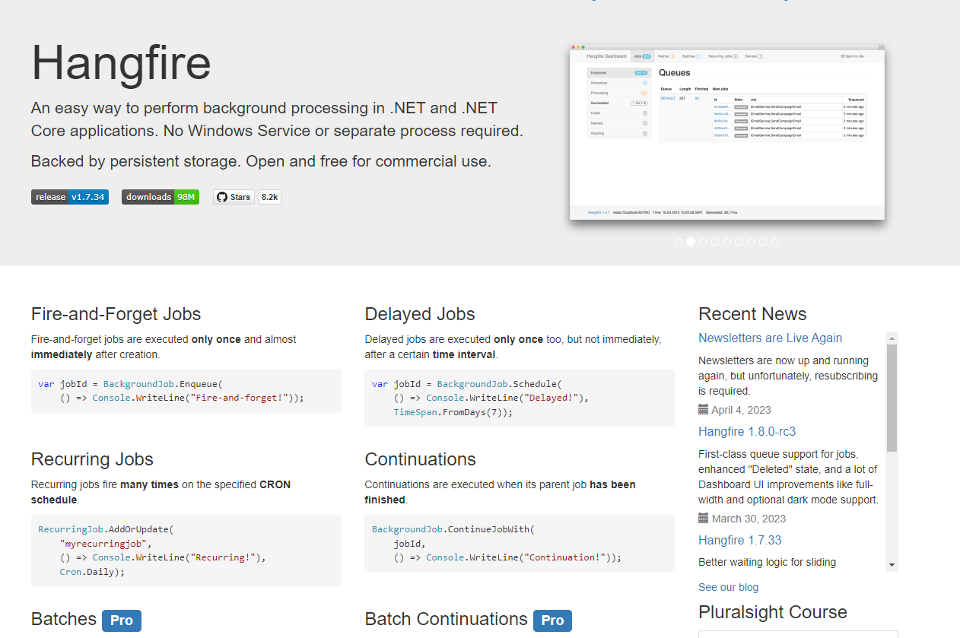
Install Hangfire
Install Hangfire as normal
Make additional changes in the code
/hangfire will throw a 404 error as such page will not exist in your Umbraco website.
You will still login with a Hangfire user name and password to see the Hangfire dashboard but there is a better way!
You will need to make additional code changes to make things work.

Slide 11
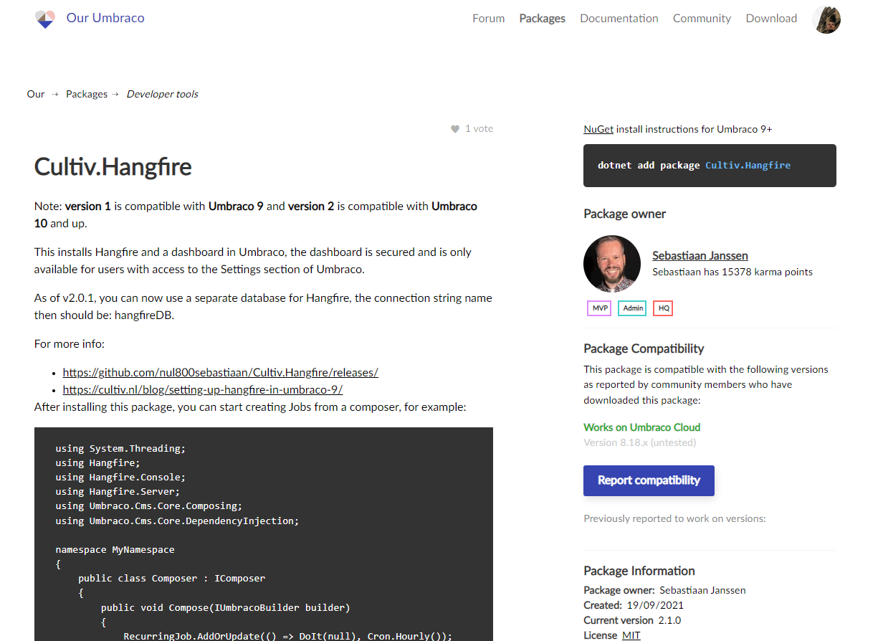
Install Cultiv.Hangfire
Simple installation and set up
Installs both Hangfire and an Umbraco Hangfire Dashboard
The Dashboard is secured and is only availble for users with access to the Settings section of Umbraco
Good documentation by both Sebastiaan Janssen and Hangfire

Slide 12
Creating Hangfire jobs with Cultiv.Hangfire on Umbraco v10+

Slide 13
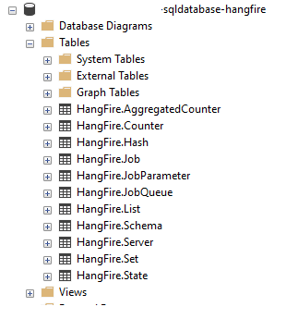

Step 1 – Installation – Cultiv.Hangfire and Hangfire database
Install Cultiv.Hangfire (v2.1.0) Nuget package.
If you want to run the Hangfire jobs on a seperate database, other than the Umbraco database, create a new empty database.
Add a new connection string, name it as hangfireDB and add the connection string details of your new database.
Notes:
Seperate db is recommended as a lot of Hangfire tables will be created

Slide 14
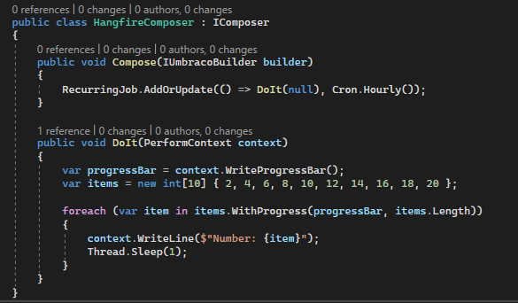
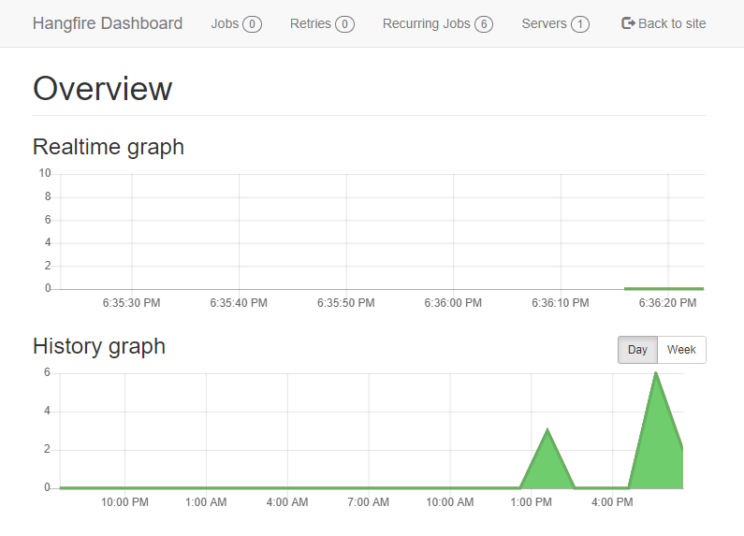
Step 2 – Initial Tests
Follow the Cultiv.Hangfire (v2.1.0) documentation and create the following simple recurring job.
Build, run your app and login to Umbraco backoffice.
Check that you have a Hangfire tab in the Settings section and your test job is running.
Notes:
Seperate db is recommended as a lot of Hangfire tables will be created

Slide 15
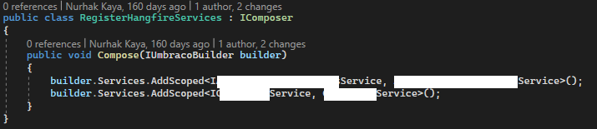
Step 3 – Create your services and register them
Create your services
These are your interfaces and their corresponding implementation classes that will be used by your Hangfire jobs.
Regiter your Hangfire services by implementing Umbraco’s IComposer
Notes:
Seperate db is recommended as a lot of Hangfire tables will be created

Slide 16
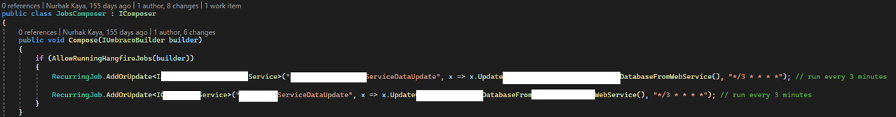
Step 4 – Create your Hangfire jobs composer and Recurring jobs
Create your Hangfire jobs composer by implementing Umbraco’s IComposer.
Add your (Recurring) jobs using your services.
Notes:
Seperate db is recommended as a lot of Hangfire tables will be created

Slide 17
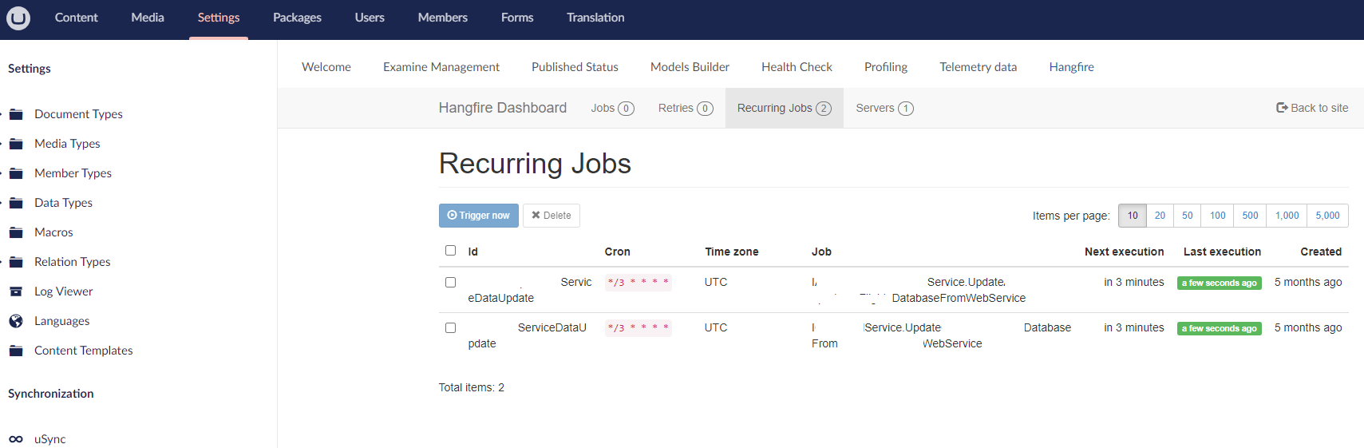
Step 5 – Check your Hangfire jobs
Login to Umbraco backoffice.
Check the Hangfire Dashboard
Notes:
Seperate db is recommended as a lot of Hangfire tables will be created

Slide 18
Final notes

Slide 19
Final notes
Using Hangfire jobs can potentially improve your website’s overall performance and availability.
Cultiv.Hanfire package simplifies things dramatically for the Umbraco websites.
When you have multiple Umbraco website instances running on multiple servers, e.g., a backoffice Website and a Front-end Website running on two different App services, make sure you don’t run the same jobs multiple times.
To stop this, one option is to create a configurable key and run the jobs only on the backoffice server. In this case, you will need to create a dummy/basic hangfire database for your front-end website.

Slide 20



Thank you for joining me today! #h5yr Any questions?
Nurhak Kaya
:https://twitter.com/nurhakkaya14
:https://www.linkedin.com/in/nurhak-kaya-53825051/
https://github.com/NurhakKaya

